Slide 1
WORLD ENERGY CONSUMPTION
TY CSE ‘ B ’
PRESENSED BY :
Om kunte (cs6302)
Mustaqeem shaikh (cs6311)
Gaurav gadekar (cs6315)

Slide 2

INTRODUCTION
This project aims to analyze global energy consumption data and identify patterns to optimize energy usage using machine learning techniques.

Slide 3

PROBLEM OVERVIEW
1. Increasing Energy Demand:
With population growth and industrial expansion, global energy consumption is rising rapidly. Efficient energy management is crucial to meet future demands sustainably.
2. High Energy Costs:
Businesses and households face rising electricity costs. Understanding consumption patterns can help optimize usage, reduce waste, and lower expenses.
3. Lack of Data-Driven Decision Making:
Most energy management decisions are made without real-time data analysis. Machine learning models can provide predictive insights to optimize energy consumption.
Would you like me to update the PowerPoint with this expanded problem overview?

Slide 4
SCOPE OF PROJECT
This project focuses on analyzing energy consumption based on environmental factors, occupancy, and renewable energy contribution. Machine learning models will be used for prediction and optimization.

Slide 5

Benefits OF PROJECT
Improved energy efficiency
Cost savings through optimized consumption
Better integration of renewable energy sources
Reduced environmental impact

Slide 6
DATA COLLECTION
The dataset includes timestamped energy consumption data, environmental conditions, occupancy levels, and operational status of HVAC and lighting systems.

Slide 7
INSIGHT OF DATA
Energy consumption is highly correlated with temperature (+0.70), indicating heating/cooling demand.
Occupancy has a weaker correlation (+0.19), meaning energy usage isn't solely dependent on the number of people.
Renewable energy has a slight positive effect (+0.08), suggesting further integration could help efficiency.
Humidity and building size have minimal impact on energy consumption.

Slide 8
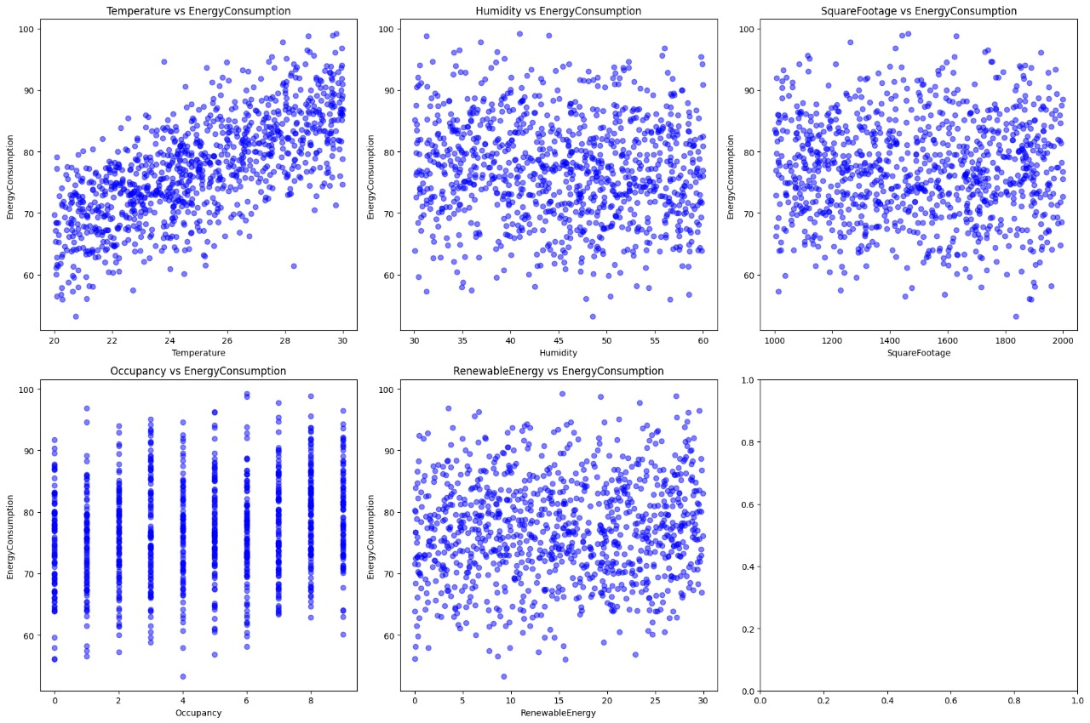

Slide 9

THANK YOU

